Slide 1


CSCE 5640 Operating System Design
Computer Science and Engineering
University of North Texas
Fall 2024

Slide 2
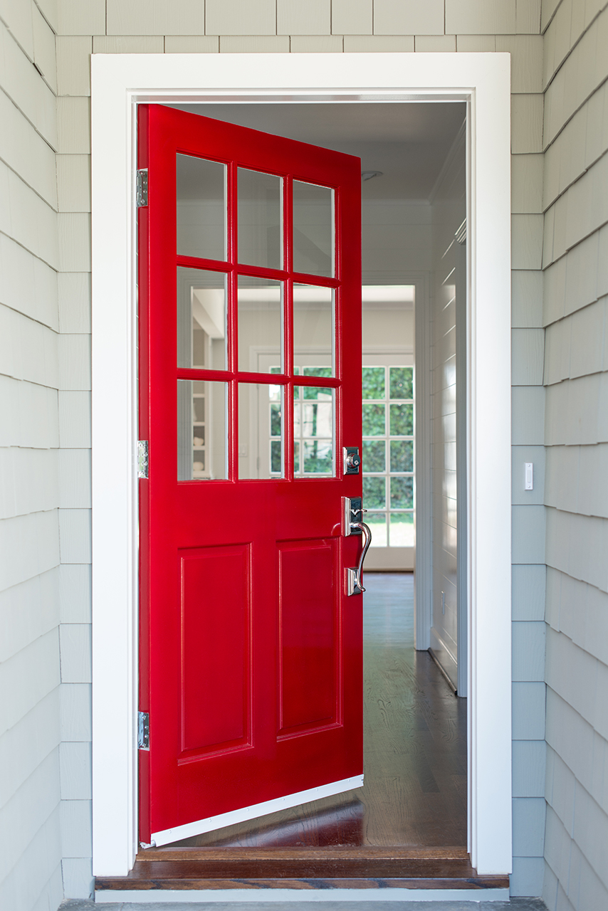
Welcome to CSCE 5640
Sign into the class page on Canvas (https://unt.instructure.com)
Class Dates: Aug 21st, 2024 – Dec 15th, 2024.

Slide 3
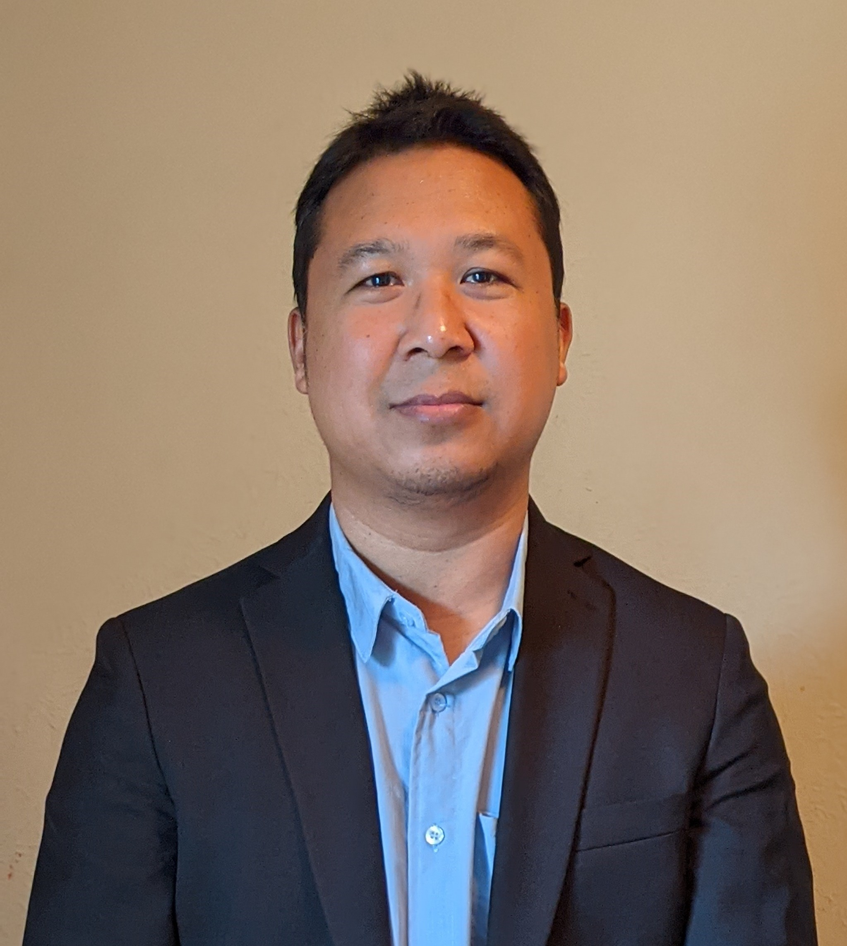

Your Instructor
Dr. Amar M. Maharjan
amar.maharjan@unt.edu
Member of the Computer Vision and Intelligent System (CoVIS)
Dr. Xiaohui Yuan
Computer Vision
Machine Learning
Human Pose Estimation
Clinical Assistant Professor in CSE at UNT.
9 years of industry experiences.
Embedded systems
Desktop, web, mobile applications
Font technologies

Slide 4

TA(s) and IA(s)
Prashanth Vangari, PrashanthVangari@my.unt.edu
Fatima Maher Shibli, FatimaShibli@my.unt.edu
Alex Michael Weaver, AlexWeaver2@my.unt.edu
See canvas page: “TAs/IAs: Office Hours Information” for office hours and more.

Slide 5


Infrastructure
We’ll be using Canvas for course grade, course content, and assignment management
https://unt.instructure.com
Textbook
Operating System Concepts (10th Edition), by Abraham Silberschatz, Peter B. Galvin, and Greg Gagne, Wiley, 2018, ISBN 978-1-118-06333-0.
Optional textbook
Modern Operating Systems, 5th edition, Published by Pearson, Andrew S. Tanenbaum, ISBN-13: 9780137618873

Slide 6

Your class (lecture)
Students are expected to attend class
Get the most for your money (tuition)!
Feel free to bring electronic devices, but do not disrupt the class!
Assignments, Homeworks, Gradings
Academic Dishonesty

Slide 7

CSE Server and other resources you may need
An SSH client software package such as PuTTY, the MAC Terminal or other
An SFTP/SCP tool such as WinSCP, Filezilla or other
A local editor and C/C++ compiler if you want to work offline
Internet access to connect to the CSE Server “Farm” or “Cluster”
See the following documents in the Course Information module on Canvas
Accessing CSE Servers.pdf
Linux Quick Reference.pdf
Nano_Cheat_Sheet.pdf
VI-Help-Sheet-011.pdf

Slide 8

Expectations
Show up for class and participate.
Turn in all assignments on time.
Honesty in doing your own work.
Respect for the instructor and TAs/IAs.
Timely discussion of any problems (10 business days).

Slide 9



Being Successful in this Course
Come to class, come prepared, do your own work, and get the most from this class.
There is no silver bullet!
Pay attention to announcements in class and on Canvas (and e-mails)
Communication should be done using UNT e-mail
You are expected to check regularly for e-mail!
Turn in assignments on time!
Key: start your assignment early.
Get help from your instructor, or the TAs, IAs, (or Peer Mentors) assigned to this course
Don’t wait to the last minute!
Do the bonus work, if anything, to challenge yourself and learn something new!

Slide 10

Syllabus
Let’s take a look!

Slide 11


Thank you
Questions and Discussion

